Slide 1
Daily Activity Fitness Tracker
Medha Mallampati SHP Rutgers University BINF5900: Data Science Programming (Advanced Python) Instructor: Dr. Riddhi Vyas

Slide 2
Objectives
Utilize advanced python tools and libraries (Numpy, Panda, Matplotlib, Scipy) to analyze Activity data.
Data download, cleaning, and preparation.
Join multiple dataset tables
Add new columns to merged dataset
Run statistical analysis tests
Generate various analytical reports to show:
List Daily Summary data
List average Calories, Step Total, Activity Minutes, and Activity Distance by Id
Display Statistics of the Total criteria columns in Activity dataset
List the Correlation between Step Total and Calories by Id
Perform Linear Regression to analyze if Calories is impacted by Total Active Distance and Total Active Minutes
Run a t-test to see if the mean of Step Total is equal to the recommended step total 10,000
Generate data visualization charts for the above reports.

Slide 3
About Data
The data was taken from the Kaggle Fitbit Fitness Tracker Data file
Files were downloaded and saved as .csv files
Only tables related to Daily Activity were taken:
Daily Calories
Daily Steps
Daily Intensities
Daily Sleep

Slide 4
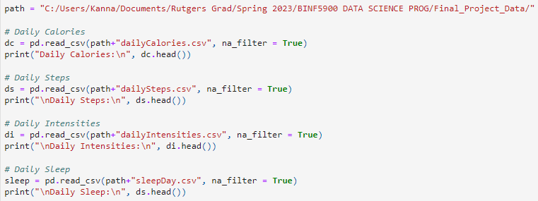

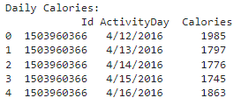
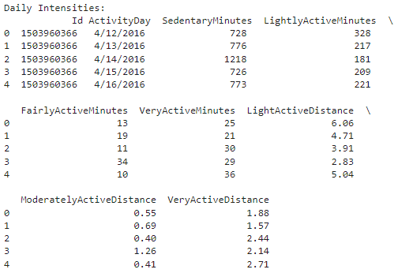
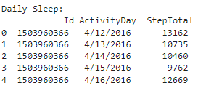
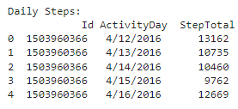
Loading the Datasets

Slide 5
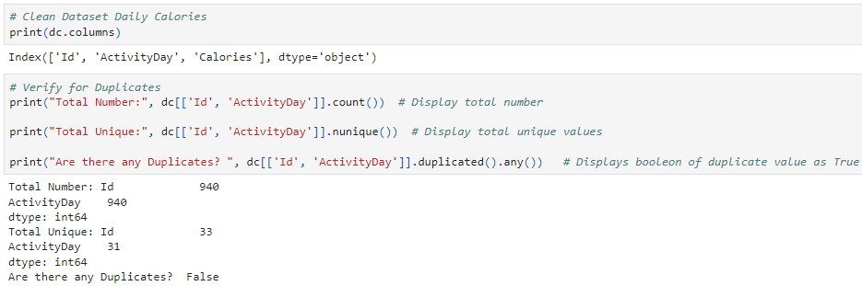
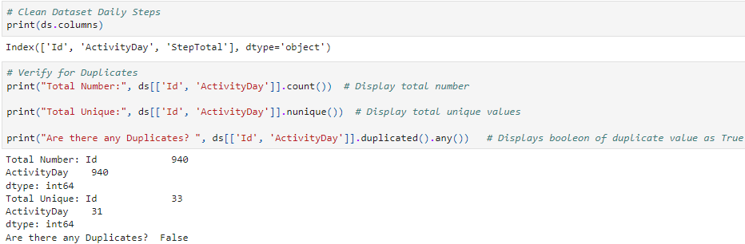
Cleaning and Validating Datasets

Slide 6
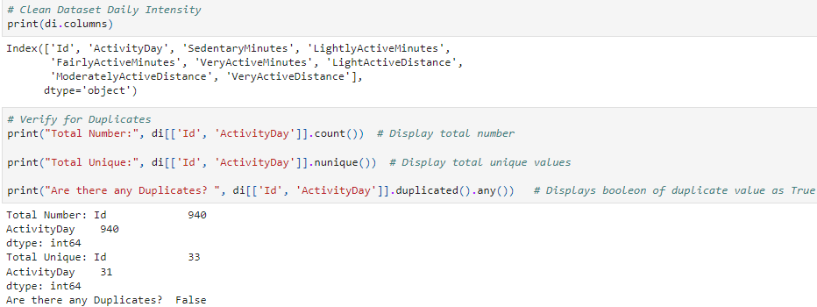
Cleaning and Validating Datasets
There is no duplicate data in the first three dataset tables Daily Calories, Daily Steps, and Daily Intensity, indicated by the Boolean output False.

Slide 7
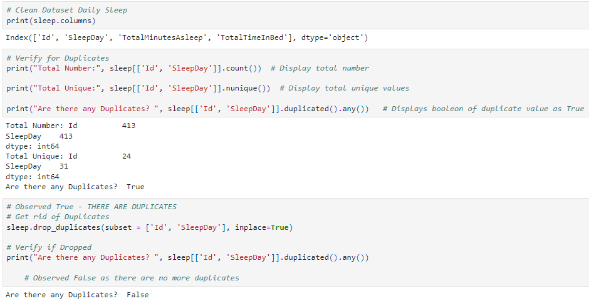
Cleaning and Validating Datasets

Slide 8

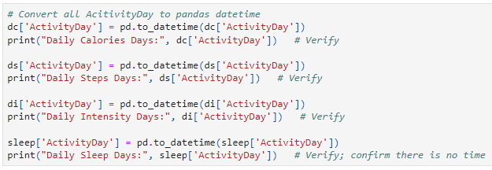
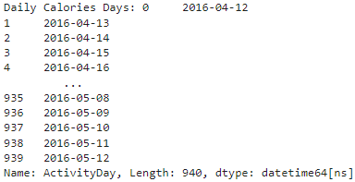
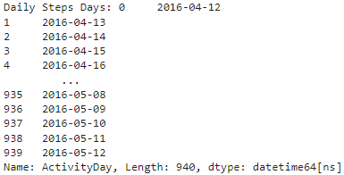
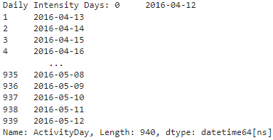
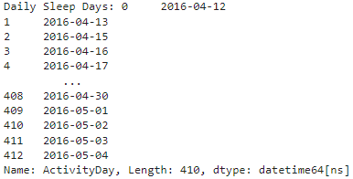
Cleaning and Validating Datasets

Slide 9
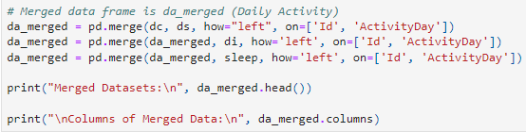
Merging the Datasets

Slide 10
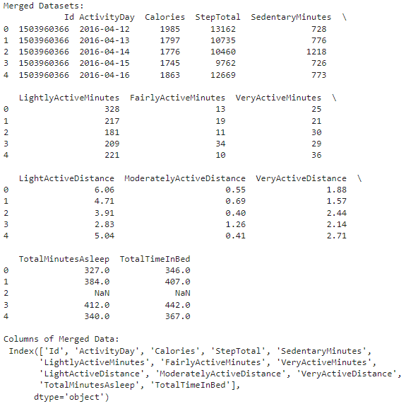

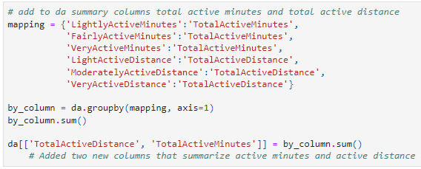

Slide 11

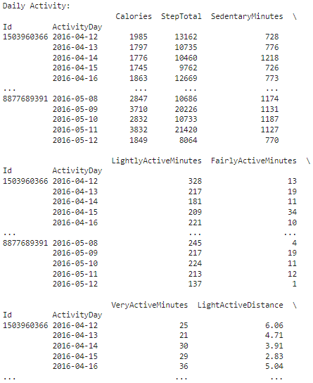
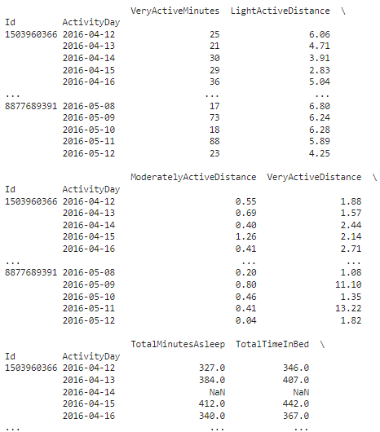
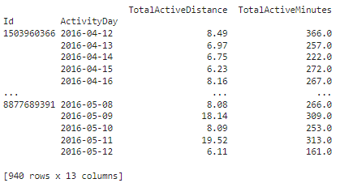
Activity Data – final merged dataset

Slide 12
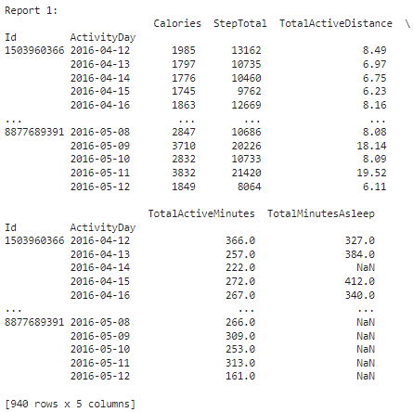

Report 1
List Daily Summary data with Total Calories, Total Steps, Total Active Minutes, Total Active Distance, Total Minutes Asleep.
The displayed report 1 makes it easier to view at a glance the necessary data for the individuals daily report, all related to the days activity total.

Slide 13
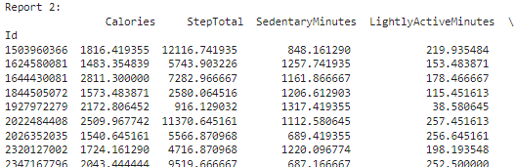
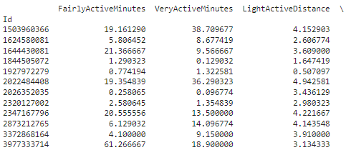

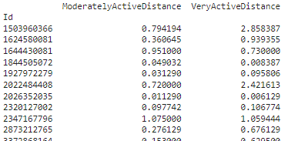
Report 2
List average Calories, Step Total, Activity Minutes, and Activity Distance by Id.
The displayed report 2 is related to the individuals overall average activity intensity breakdown.

Slide 14
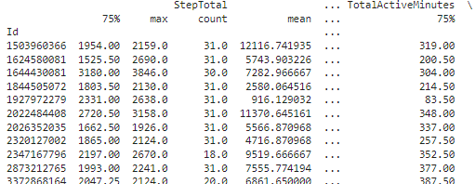
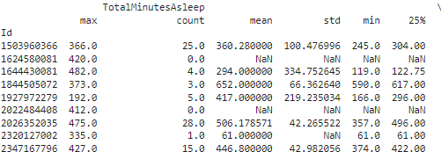

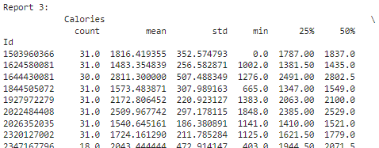
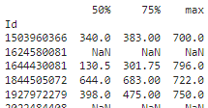
Report 3
Display Statistics for data by Id with Total Calories, Total Steps, Total Active Minutes, Total Active Distance, Total Minutes Asleep.
Report 3 displays the overall statistics of the individuals daily total data. This allows us to see who was the most active, who was the least active, what their max/min calorie expenditure was and overall average.

Slide 15
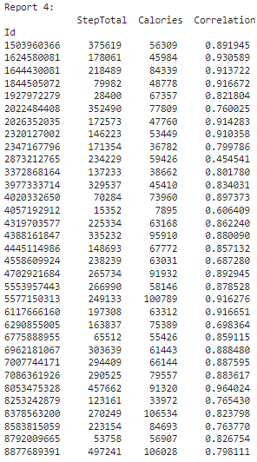

Report 4
List for each Id, correlation between Total Steps and Calories.

Slide 16
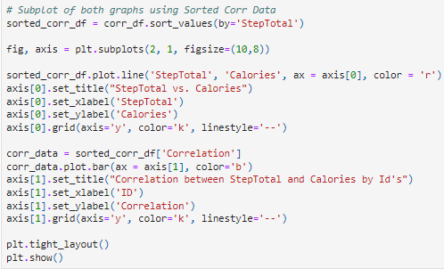
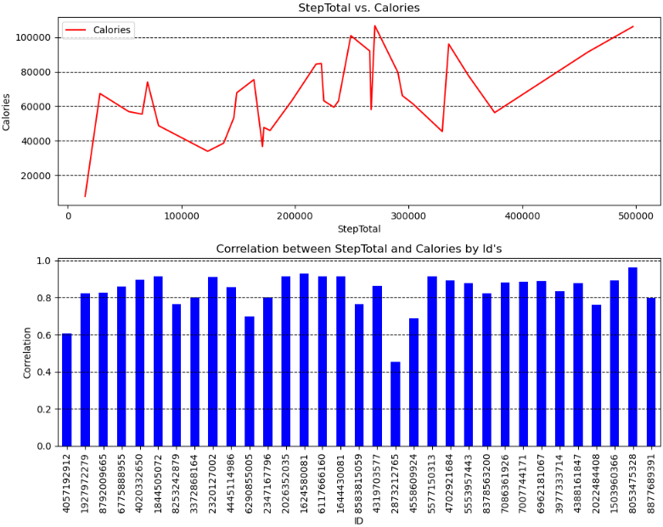
Report 4 displays the correlation values for each individual, showing who had the highest correlation between total steps and calories. Overall, looking at the correlation values and displayed graph charts, it seems that there is a high positive correlation between total steps walked and calories expended with few deviations. The individual where it can be considered an outlier would be Id #2873212765, where the correlation value is equal to 0.454, considered a low positive correlation.

Slide 17
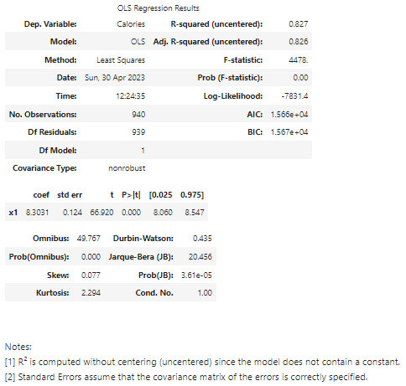
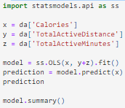
Report 5
Perform Linear Regression to analyze if Calories is impacted by Total Active Distance and Total Active Minutes

Slide 18
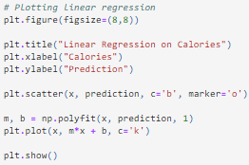
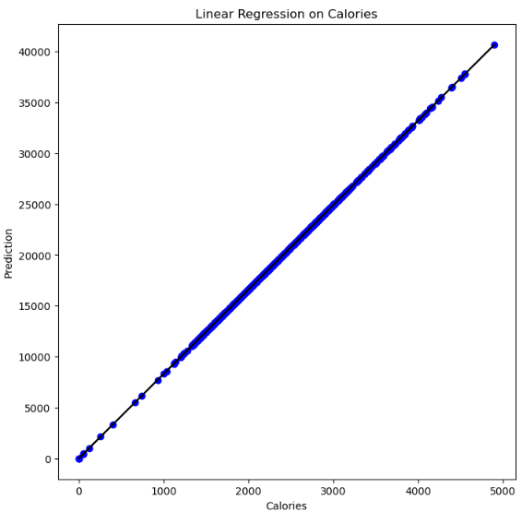
The linear regression model for report 5 gives an output summary to view. The r² value is equal to 0.827. This value is statistically significant and therefore indicating an 88.3% variation on calories.
The coefficient value is equal to 8.3031, which means if the independent values Total Active Distance and Total Active Minutes change by this amount, the dependent variable Calories will increase.
There is also only a standard error of 0.124 between the actual and predicted values.

Slide 19



Report 6
Is the mean of Step Total equal to the recommended step total 10,000?
First, we check if we can run the t-test required for the question. The data has more than 30 entries, passing the first requirement. Next, checking for normality of StepTotal, we see that the p-value is equal to 2.4709, indicating that the data is the same as normal distribution.
After checking if the data passes the necessary requirements, we move onto answering the question by running a One Sample t-test. The outputted p-value after running the statistical test is equal to 8.739, indicating the mean of the Total Steps is equal to 10,000.

Slide 20
References
1. FitBit Fitness Tracker Data. www.kaggle.com. https://www.kaggle.com/datasets/arashnic/fitbit

